Slide 1
AI HACKATHON 2019
STAGE II
Grading of Onion in Real-time
Team ID: AIH19T-0175
Name | Organization | Email ID
Shantanu Ghar | SIES Graduate School of Technology | shantanu.ghar16@siesgst.ac.in
Venkhatesh Arunachalam | SIES Graduate School of Technology | venkhatesh.arunachalam16@siesgst.ac.in
Sayali Patil | SIES Graduate School of Technology | sayali.patil16@siesgst.ac.in

Slide 2
OUTLINE
Part I: Related work
Part II: Data Understanding
Part III: State of the art
Part IV: Experimental evaluation

Slide 3
Part I: Related Work
Onion is one of the most frequently purchased vegetable worldwide, yet it has some defects which cannot be identified without human intervention , this is one of the leading threats to onion supply chain management and profitability.
In the past, various techniques such as computer X-ray Tomography, Positron Emission Tomography, etc were used for studying the defects, but the cost of installing the equipment was unfeasible for warehouses within developing nations.
In present, a new technique Optical Coherence Tomography has emerged as a viable solution but again installing the required instruments is an expensive process, so usually defective onions are identified manually.
In the conventional onion sorter, image of fallen onion from a shoot is captured, and then onion is compared with some threshold value. If the parameter taken for analysis (color, moisture, weight, size, diameter) is below the threshold value, the onion is rejected as damaged one. This system has been developed taking into consideration the export rules that has been set by the Government for the export of the onion.

Slide 4
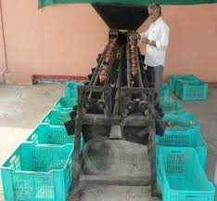
Existing systems have workers to separate the defective onions.
There are some flaws in this system, example if a cart has defective onions on the surface layer, then the entire cart is discarded without checking the layers underneath , leading to food loss.

Slide 5
Part II: Data Understanding
We used a dataset with a total of 56 images, with each image depicting the top view of an onion cart.
The defective onions within the images were classified into one or more of the 10(1 normal + 9 defects) categories, viz. rotten, smut effected, without skin, half cut, tip, neck, sprouting, double onion, sunburn.
Dataset source, dimensions, distributions and reliability.
We used a training set of 56 images, while adding 6 images as per the samples in the validations set.
Resolution of images is 4608 x 3456 pixels, both vertical and horizontal resolution equals 72dpi.

Slide 6
Part III: State of the Art
Our solution consists of two phases :-
Phase 1) Instance segmentation and localization of defective onions.
Phase 2) Actuating a robotic arm to discard defective onions
As the existing solution in India is primarily manual, and other automated solutions are either too costly, or infeasible at the warehouse level, we aimed at developing a solution that tackles both these issues .
Phase 1:- INSTANCE SEGMENTATION AND LOCALIZATION
We chose to use a Mask-RCNN model for this phase, as this deep neural network is an extension of the Faster-RCNN, adding an overhead of only 5fps, but providing us with the masks of the detected classes, as well as bounding boxes.
Another reason was the size of the provided dataset. We only had a limited number of images to train, and this constraint is handled well by MaskRCNN because in the trade off between dataset size/ training time, it chooses to have a smaller dataset coupled with a large training time, to give the best possible results.

Slide 7
State of the Art
While existing solution require X-ray/lasers/ethylene gas treatment and other such techniques that virtually penetrate through the onions and then analyse them, our solution does its analysis from a distance, leaving the onions untouched from such radioactivity.
The tech stack workflow is explained in the diagram, and we’ll elaborate it here:-
1)App clicks the image of the cart full of onions and uploads the image on Firebase.
2)A remote listener on a Python Script detects the change in the uploaded node and downloads the image, which is passed to the model as an argument.
3) The model starts analyzing the provided image, and performs segmentation and draws bounding boxes around the detected onions, while calculating the coordinates of each defective onion. Later a python script uploads the count of the defective onion along with the corresponding defects on the realtime database.
4)The app now fetches the defective onion data and plots a bar graph for every cart, and clicking on a bar graph shows a detailed pie chart depicting the various defects found within the cart. These kind of analytics are vital for warehouses, to maintain an automated distribution of defective onions.

Slide 8
State of the Art
PHASE 2 :- ACTUATION OF ROBOTIC ARM TO DISCARD ONIONS
While segmentation and analytics are of high importance, it is equally important to eliminate the human intervention in the discarding process, for which, we have created a robotic arm that uses the bounding boxes provided by MaskRCNN to localize and identify the exact defective onions that it needs to discard.
1)The arm is capable of moving in three axes and uses three high torque servo motors (8.5 kg/cm) for axial movement and three low torque servos (1.5 kg/cm) for the claw mechanism.
2)We have used and Arduino Uno, along with servo MG995 and servo SG90 and an acrylic arm body for this demoable version.
3)From a corner mounted position, the arm has 3 degrees of freedom (XY for adjusting height,XZ- rotatory for the discarding manoeuvre, and YZ for extending reach).
4)The arm has a three finger claw with an angle of 120 degrees between each finger, to ensure the best possible grip on the onions of all shapes and sizes.

Slide 9
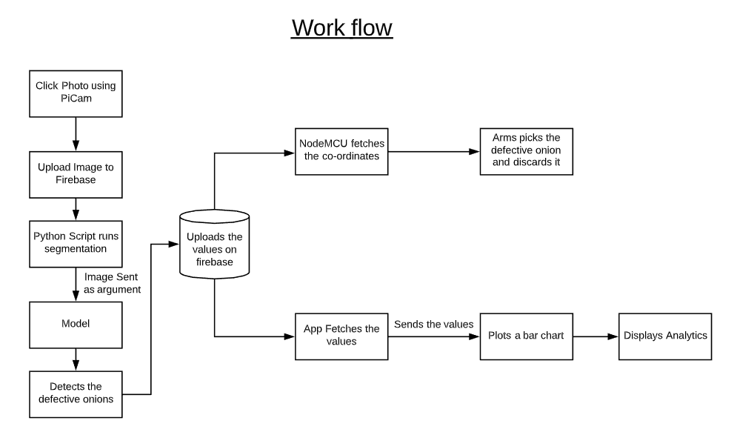

Slide 10

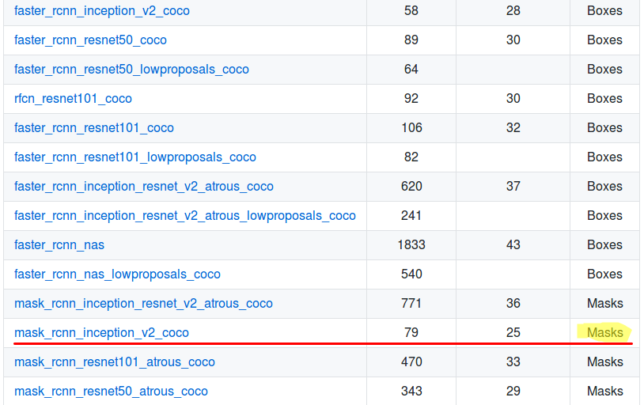
Part IV: Experimental Evaluation

Slide 11
HOW TO REPRODUCE THE RESULT
Steps to run the model
Step 1:
Download Mask-rcnn Files from Google Drive Drive link
Change path to Mask_RCNN-master/samples
Run python script i.e. python testFirestorage.py
keep the python file running and go to step2
The above script looks for image from the firebase storage bucket
Step 2:
Download APK to take picture which is located in the drive apk link
Install APK and upload images from android phone
Python script will automatically fetch image from firebase bucket and will display the inference output
Step 3:Discarding of the defective Onion using arm is demonstrated in the video

Slide 12
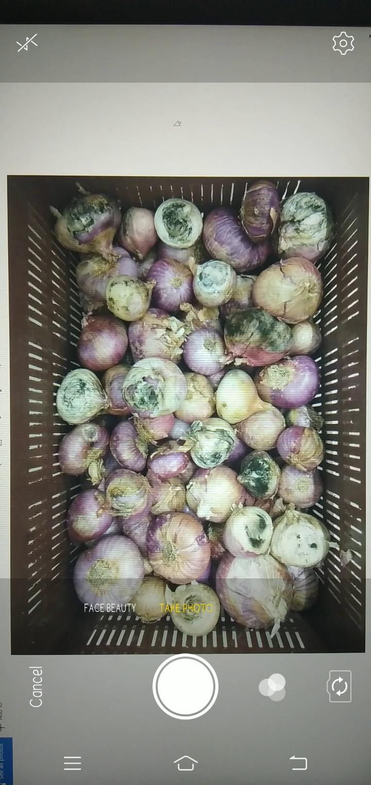
In this App, we click image of the cart and upload it on Firebase.
This image is then used by the model for detection.

Slide 13

Working of Robotic Arm

Slide 14
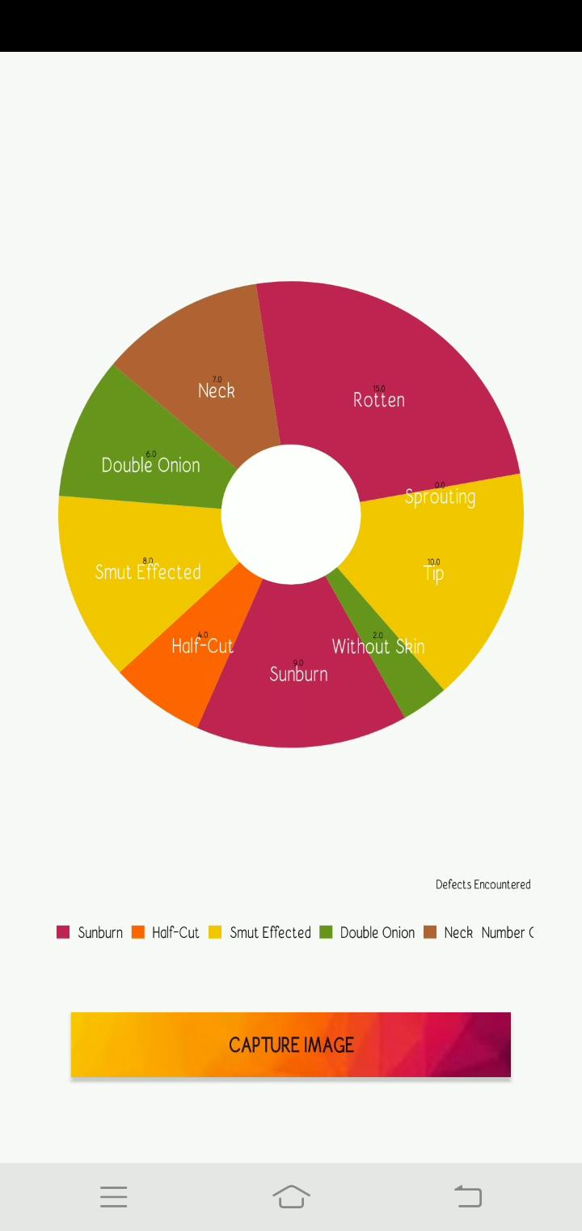
Working of the App.
App displays the number of defective onions per tray in form of a bar chart.
The defect type along with the count is shown in form of a pie chart, this is shown tray-wise.
App displays the count realtime.

Slide 15
SUMMARY
In our current implementation we’ve focussed on building a prototype that can perform segmentation and locate defective onions, while building a backend that provides analytics tools and visual aid.
Our robotic arm prototype is capable of picking up and discarding an onion from a corner mounted position.
The image upload feature in the android app is analogous to the PiCam that we’ll implement in the complete solution.

Slide 16
SUMMARY: FUTURE DIRECTIONS
While we have presented our overall prototype, for the solution to reach its full potential, we have identified a list of things that we are planning to build, and also implement some changes within the existing system that we discovered while building it.
Having access to the complete dataset will enable us to perform augmentation, as MaskRCNN suffers with overfitting without augmentation. This will help us in significantly reducing the loss and increase the segmentation accuracy.
We also plan at utilizing the mask’s area to streamline the targets for the robotic arm.
The robotic arm will be mounted on a locomotion module which will enable it to move around the rim of the cart with ease.
We plan at 3D printing the entire Robotic Arm + locomotion module to deliver a functional solution by the end of the hackathon, which can be mounted on top of traditional carts.
In initial prototyping, we are using app to click image of the onions. In final demonstration we will replace the app by Raspberry Pi and the image will be clicked by PiCam, this is done so that the final product is modular.

Slide 17
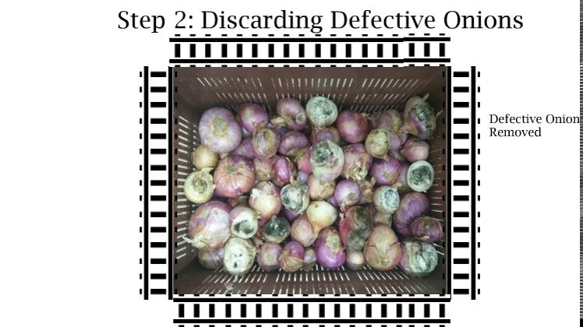
Final Solution

Slide 18
Thank you

